Slide 1
BRITISH AIRWAYS JOB SIM
DATA SCIENCE
Web scraping to gain company insights

Slide 2
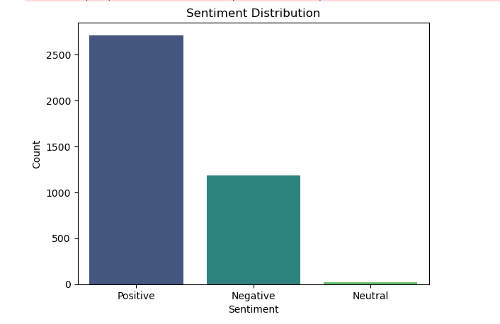
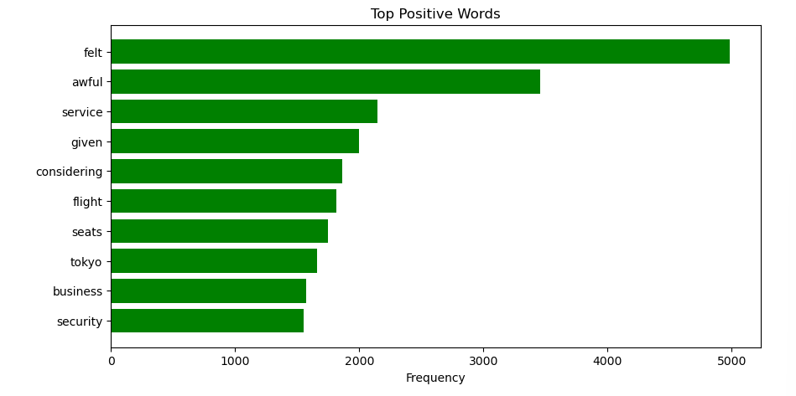
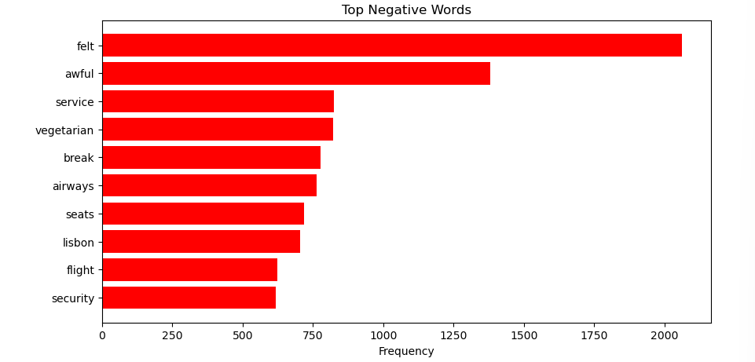
SKYTRAX flights REVIEW ANALYSIS
Sentiment Overview:
Positive Sentiment: 2710 reviews (Avg. Rating: 5.73)
Negative Sentiment: 1181 reviews (Avg. Rating: 2.36)
Neutral Sentiment: 20 reviews (Avg. Rating: 2.85)
Key Insight: Majority of customers expressed positive sentiments, though a significant number raised concerns.
Word Frequency Highlights:
• Positive: Service, Comfortable, Business Class, Security
• Negative: Seats, Vegetarian, Lisbon, Delays
Key Insight: Positive reviews focus on premium services, while negative feedback highlights discomfort and poor accommodations.
Key Recommendations:
1. Improve seating comfort in economy class.
2. Enhance dietary options, focusing on vegetarian meals.
3. Investigate issues on specific routes like Lisbon.
4. Expand and promote premium services like business class and security.
Aspect | Positive Feedback | Negative Feedback
Top Words | "Service," "Comfort," "Tokyo" | "Seats," "Vegetarian," "Lisbon"
Recurring Themes | Business class, security | Dietary preferences, delays

